Slide 1
Biologically-inspired Computing II: Neural Networks
CSCI 4360/6360 Data Science II

Slide 2
Survey
Who’s heard of artificial neural networks?
Who knows what a neuron or synapse is?
Who knows what an activation function is? Different types?
Input layers, hidden layers, output layers?
Who’s heard of deep learning?

Slide 3
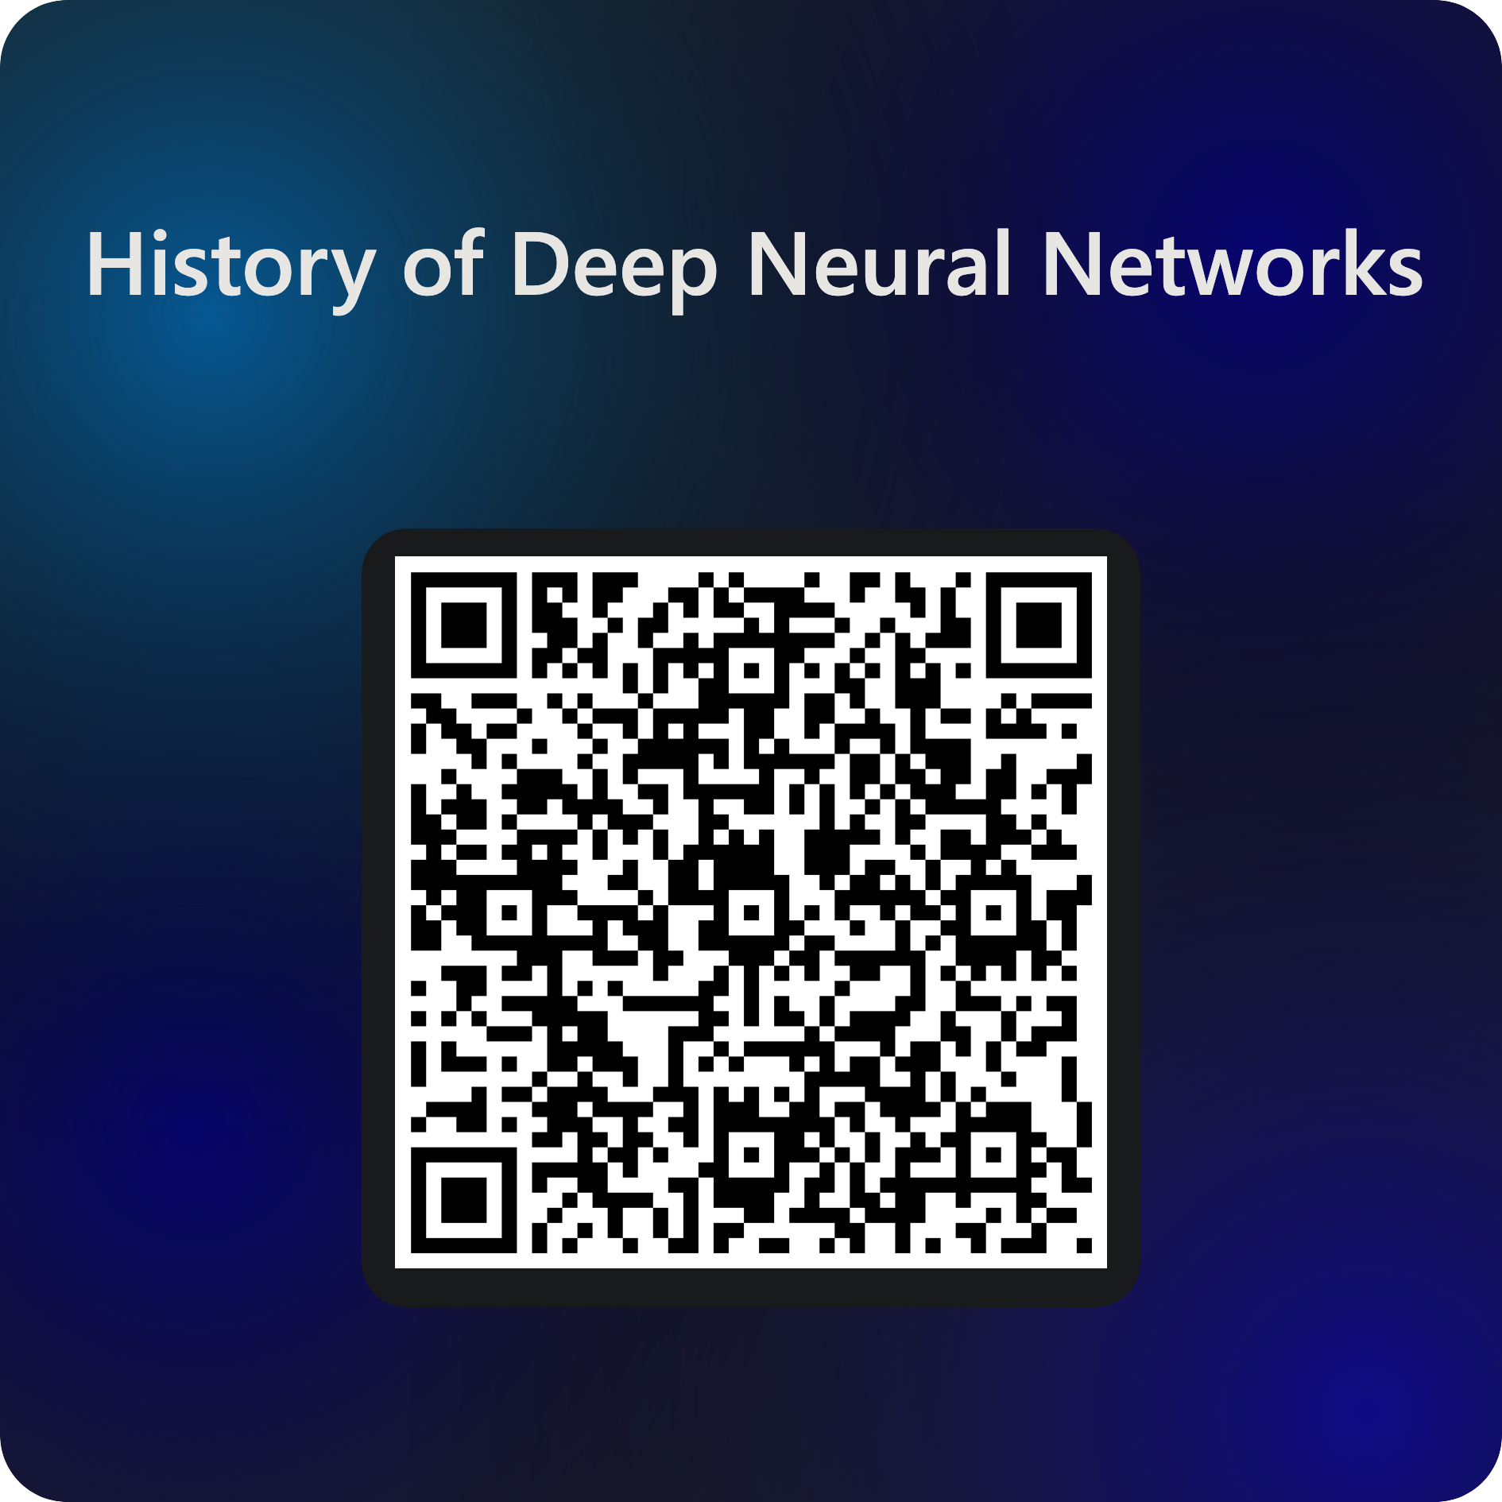

History of Neural Networks

Slide 4
Artificial Neural Networks
Not a new concept!
Roots as far back as 1940s work in unsuperivsed learning
Took off in 1980s and 1990s
Waned in 2000s
“Biologically-inspired” computing
May or may not be true
Shift from rule-based to emergent learning

Slide 5
Artificial Neural Networks
Kind-of modeled after biological brains
Hence: “artificial”
Neurons: basic unit of thought and computation
Synapses: connections between neurons
Activation functions: determine whether or not a neuron “fires”, given firings (or not) of previous connected neurons

Slide 6
Artificial Neural Networks
ANNs organized into layers
Each layer is a collection of neurons
Each neuron has an activation function that determines whether to ”fire”
Signal is propagated to the next layer

Slide 7
Artificial Neural Networks
Types of layers
Input
Output
Hidden
Types of activation functions
Identity
Step (threshold)
Linear
tanh
sigmoid
Rectified Linear (ReLU)
https://en.wikipedia.org/wiki/Activation_function#Comparison_of_activation_functions

Slide 8
Activation Functions
Among the most important architectural decisions to be made
Nonlinear: two-layer ANN can be proven to be a universal function approximator
Continuously differentiable: essential to gradient-based training of the ANN (which we use in backpropagation)
Range: gradient-based methods are more stable when range of activation function is finite (i.e., tanh is [-1, 1])

Slide 9
Single Neuron
Input neurons
Each incoming value from previous layer has a weight
Weighted sum in neuron
Activation function with a threshold
Output from neuron sent to next layer

Slide 10
Single Neuron

Slide 11
“Emergent behavior” perspective
ANNs embody the principle of “emergent behavior”: from relatively simple structure and rules comes remarkably complex phenomena
Intelligence and intelligent life
Relationship to ANNs
No central network processor
“Knowledge” is stored in the network itself (weights)
“Hierarchies” of concepts in deep networks

Slide 12
“Emergent behavior” perspective
Upshot: ANN-based artificial intelligence isn’t going to emerge anytime soon
Also called “connectionist” models
Humans
Neuron switching time: ~0.001s
Number of neurons: ~10¹⁰
Connections per neuron: ~10⁴-10⁵
Scene recognition time: ~0.1s
Significant parallel computation
ANNs
Neuron-like switching units (usually ~10⁴; GPT-4 has 10¹² parameters)
Weighted interconnections among units (usually 10²-10³)
Some parallel computation (limited by hardware, networks, etc)

Slide 13
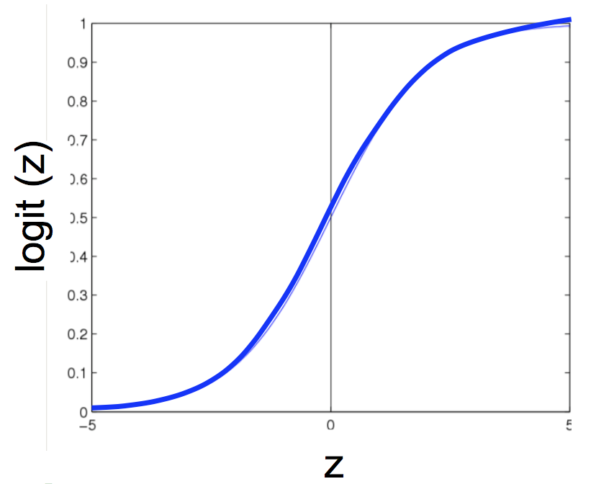
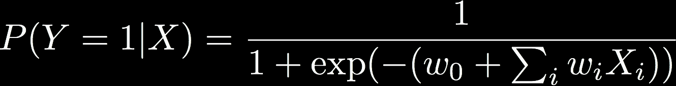

Logistic Regression
Remember logistic regression?
Functional form of classifier
Logit function applied to a weighted linear combination of the data

Slide 14
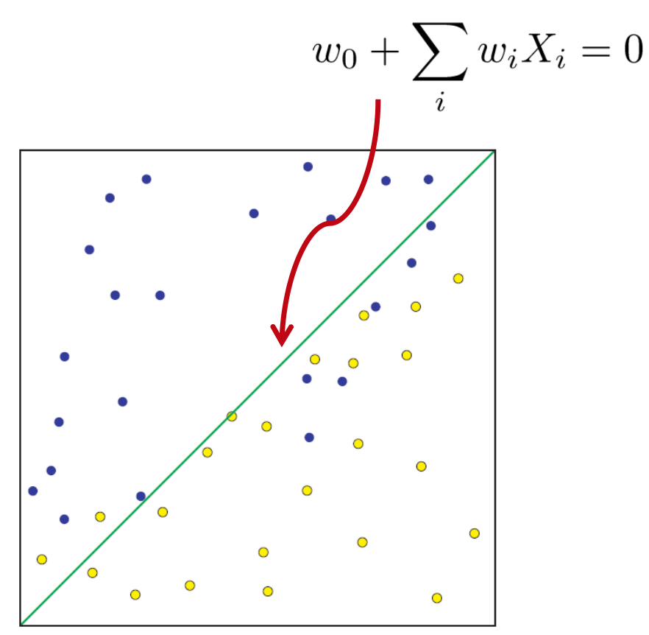
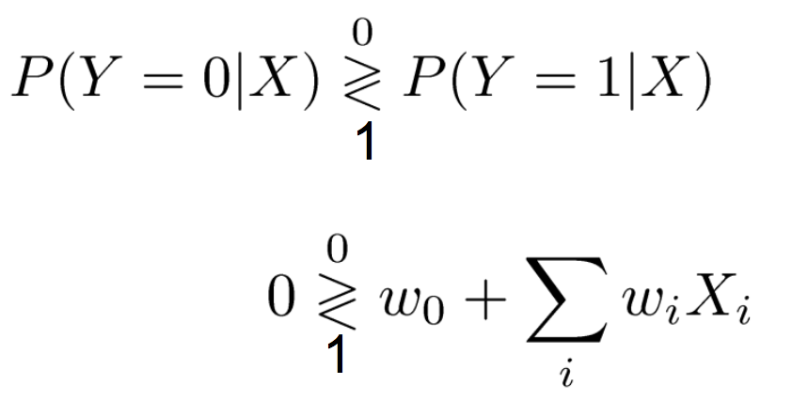
Logistic Regression
LR is a linear classifier

Slide 15
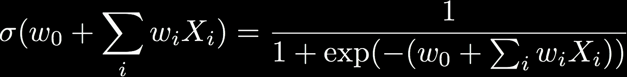
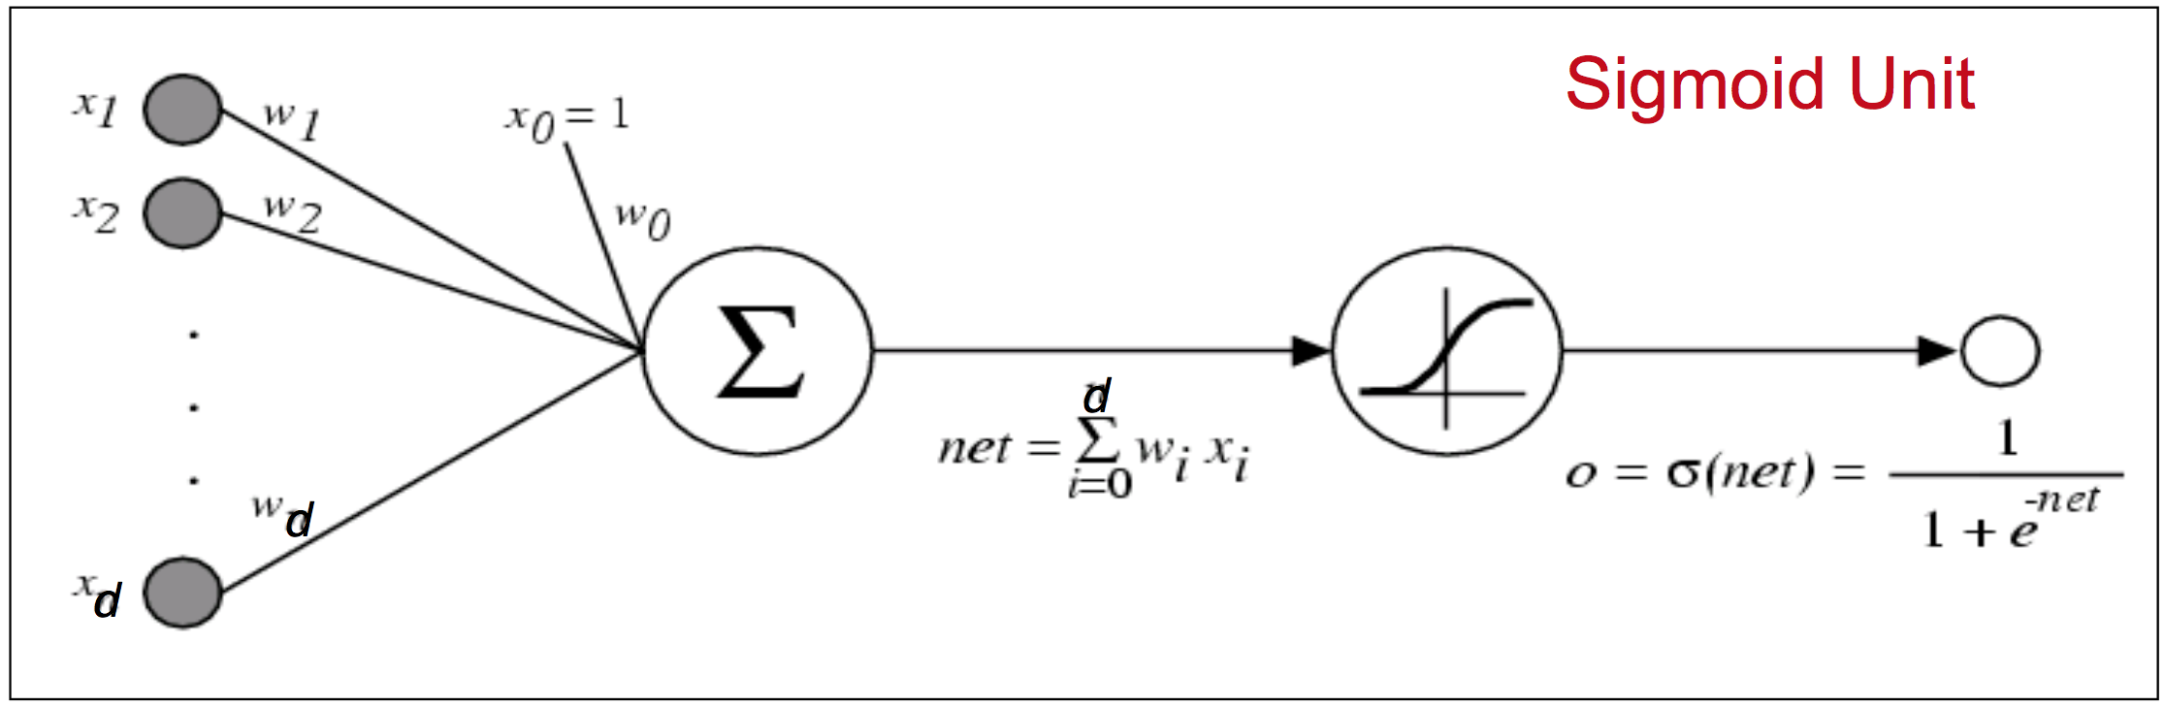
LR as a Graph
Define output o(x) =

Slide 16
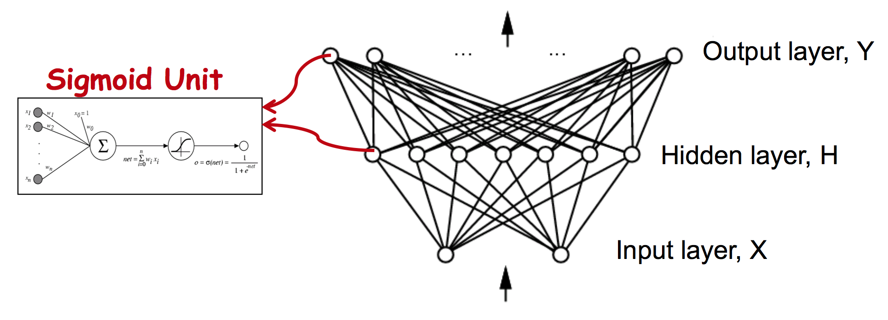
Properties of ANNs
ANNs learn some f : X→ Y
X and Y can be continuous / discrete variables
Focus on feed-forward neural networks
Form directed acyclic graphs, or DAGs
Will break this focus when we reach recurrent neural networks!

Slide 17
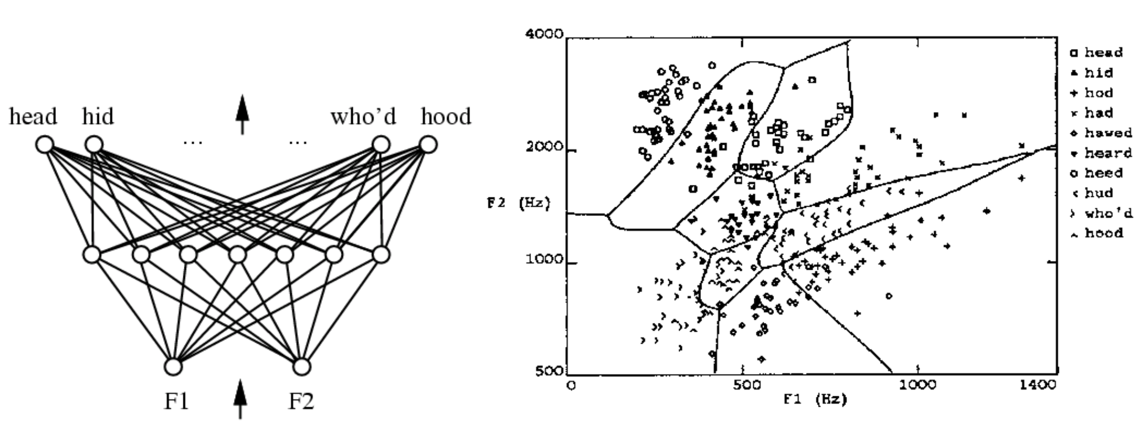
ANN in practice
Learn to differentiate homonyms using frequencies in audio

Slide 18
Deep Learning
Really a reformulation of neural networks to be “deep”
Original conception called for multilayer neural networks (“multilayer perceptrons”)
Ran into numerous problems:
Theoretical (how to optimize over parameters of deep networks?)
Empirical (gradients vanish / explode over deep networks)
Engineering (hardware isn’t capable of training deep networks)

Slide 19
Why is ”deep learning” a thing?
Concepts have been around for decades
1950s: didn’t have backpropagation theory to efficiently train perceptrons of more than 1 layer
1980s: didn’t have hardware to efficiently compute gradients for more than 2-3 hidden layers
1990s: didn’t have enough data to make deep learning feasible
2000s: too depressed with previous failures to look into neural networks; pursued e.g. SVMs instead
2010s: Deep LearningTM
2020s: Large Language Models (Transformers)

Slide 20
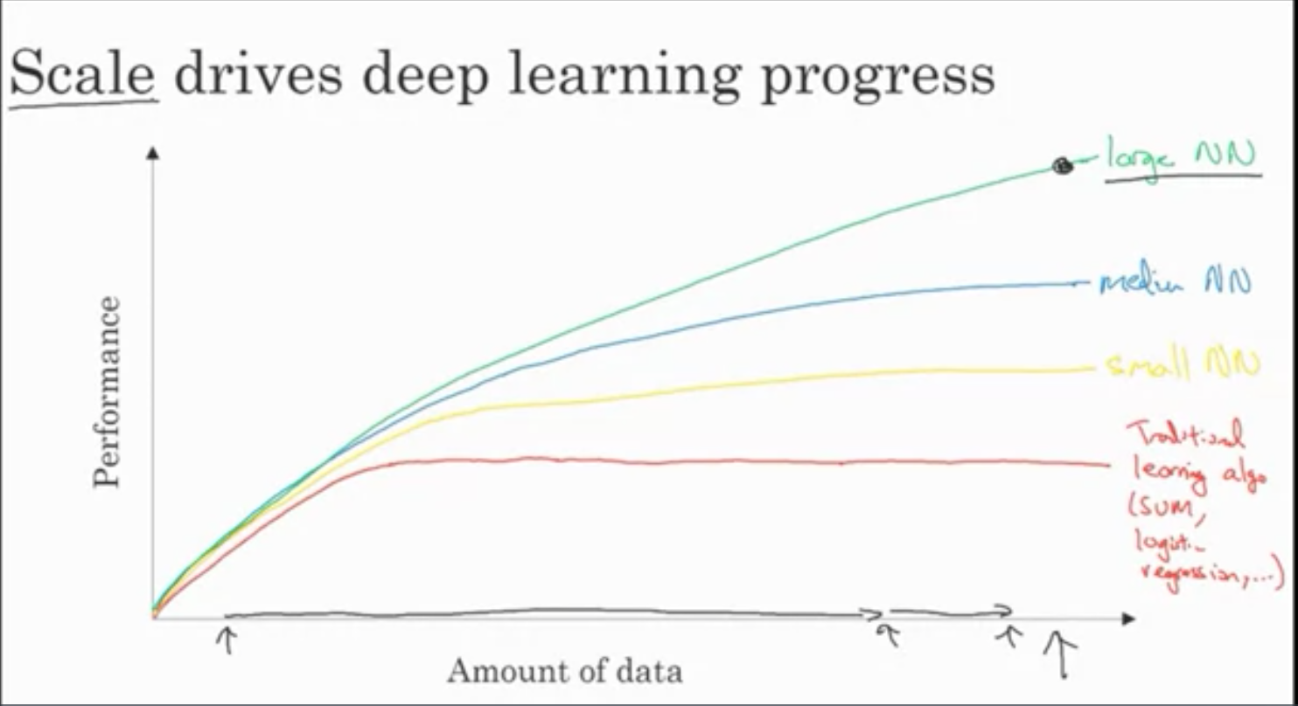
Deep Learning Catalysts
Scaling of data and computation
Data
”Big data”
Computation
Specialized hardware
Open source frameworks
Algorithms
Efficient implementations
New paradigms

Slide 21
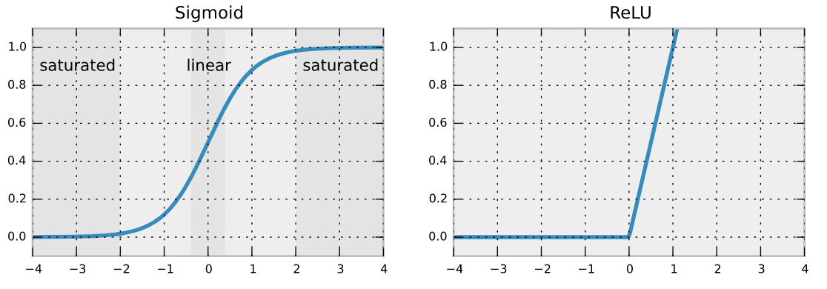
Deep Learning Catalysts
Switching from sigmoid to ReLU activation functions
Sigmoid becomes “saturated” at tails, resulting in very slow learning progress
Notes:
Gradient of ReLU is always 1, meaning the gradient won’t vanish
- gradient descent works much, much faster

Slide 22
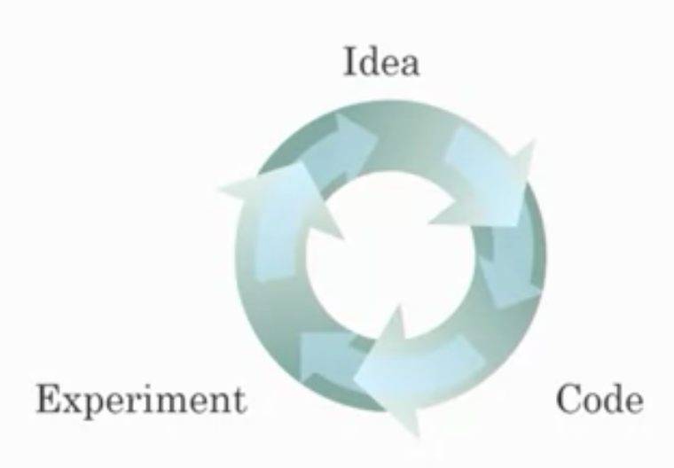
Deep Learning Catalysts
Hardware efficiency (i.e. Moore’s Law)
Faster prototyping of
New ANN architectures
New datasets
New activation functions
…
Practitioners and researchers benefit

Slide 23
TensorFlow Playground
Observe the process ANN training (concentric circles dataset)
2 inputs, 1 hidden layer (4 neurons), Sigmoid activation, L1 regularization
2 inputs, 1 hidden layer (4 neurons), ReLU activation, L1 regularization
4 inputs, 0 hidden layers, ReLU activation, L1 regularization
How many training epochs are needed?
What are the weights?

Slide 24
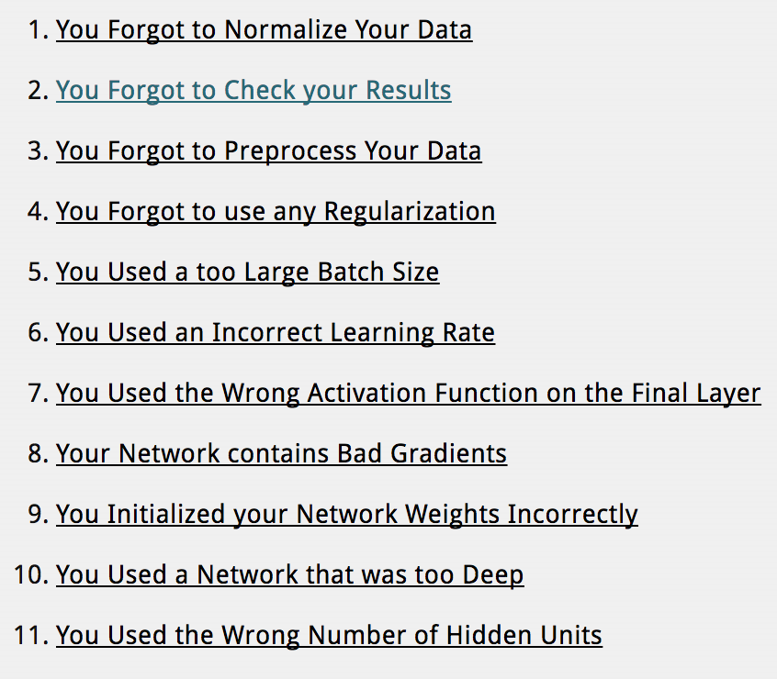
Deep Learning: Caveats
Notes:
1: absolute magnitudes will be interpreted as importance; rescale your data
2: most likely, there’s a bug in your code (machine learning ALWAYS fails silently)
3: exactly what features are you including (see the X^2 feature inputted in tensorflow playground!)
4: not just about preventing over-fitting; also has a smoothing effect on landscape (see L1 vs L2)
5: smaller batch sizes can potentially force you out of local minima, & scale better
6: keep learning rate just below error rate explosions (see TFP)
7: e.g. ReLU as final, resulting in only >0 values
8: “dead neurons” with 0 gradient—switch from ReLU to leaky ReLU or ELU
9: random initialization can actually be bad. Use existing weight initialization strategies
10: if shallower networks--3, 4, 5 layers—aren’t learning *anything*, 100 layers won’t either
11: fewer is better, as few as possible to get the job done

Slide 25
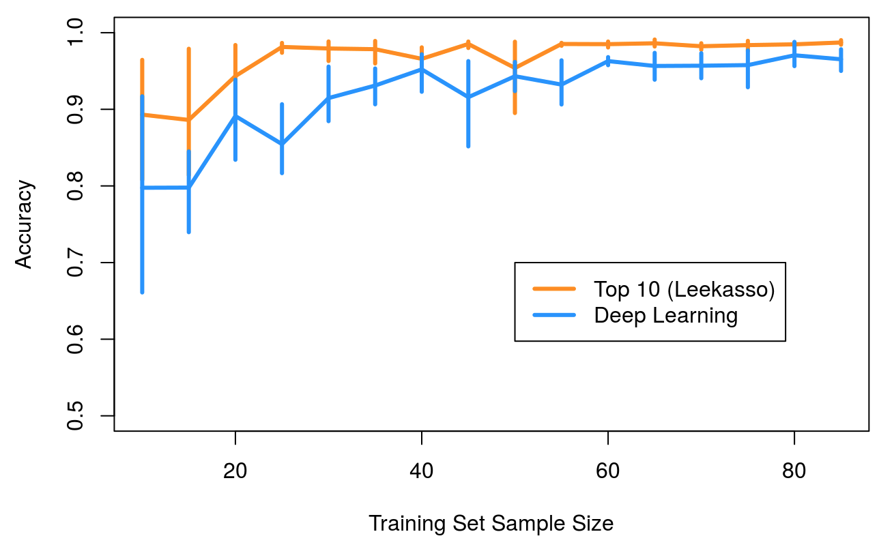
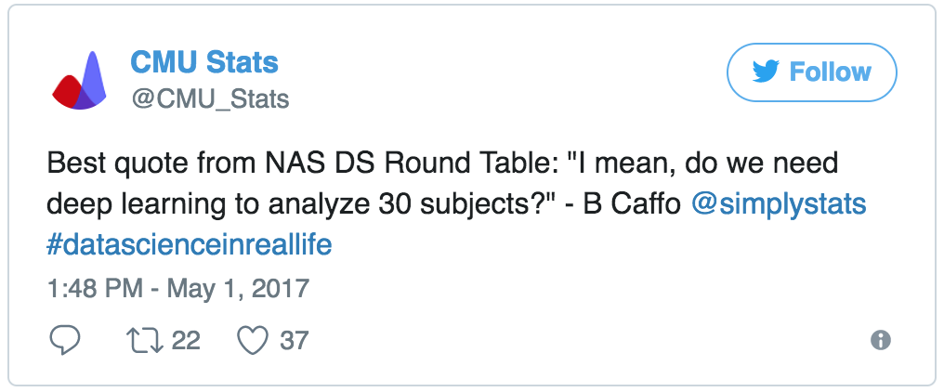
Deep Learning: More caveats
(along the lines of “don’t use Hadoop if your data isn’t that big”)
At smaller data sizes, no discernible performance bump from deep learning versus “traditional” methods
”Traditional” methods likely more interpretable and simpler to use
Notes:
”Leekasso” is 10 most informative pixels from linear classifier of MNIST dataset
Actually outperforms deep network of *all* pixels in MNIST until data reaches a certain size

Slide 26
Deep Learning: Even more caveats
Fizz Buzz (the classic interview question)
…in Tensorflow!
“Print numbers 1 through 100, except: if the number is divisible by 3 print ‘fizz’; if it’s divisible by 5 print ‘buzz’; if it’s divisible by 15 print ‘fizzbuzz’.”

Slide 27
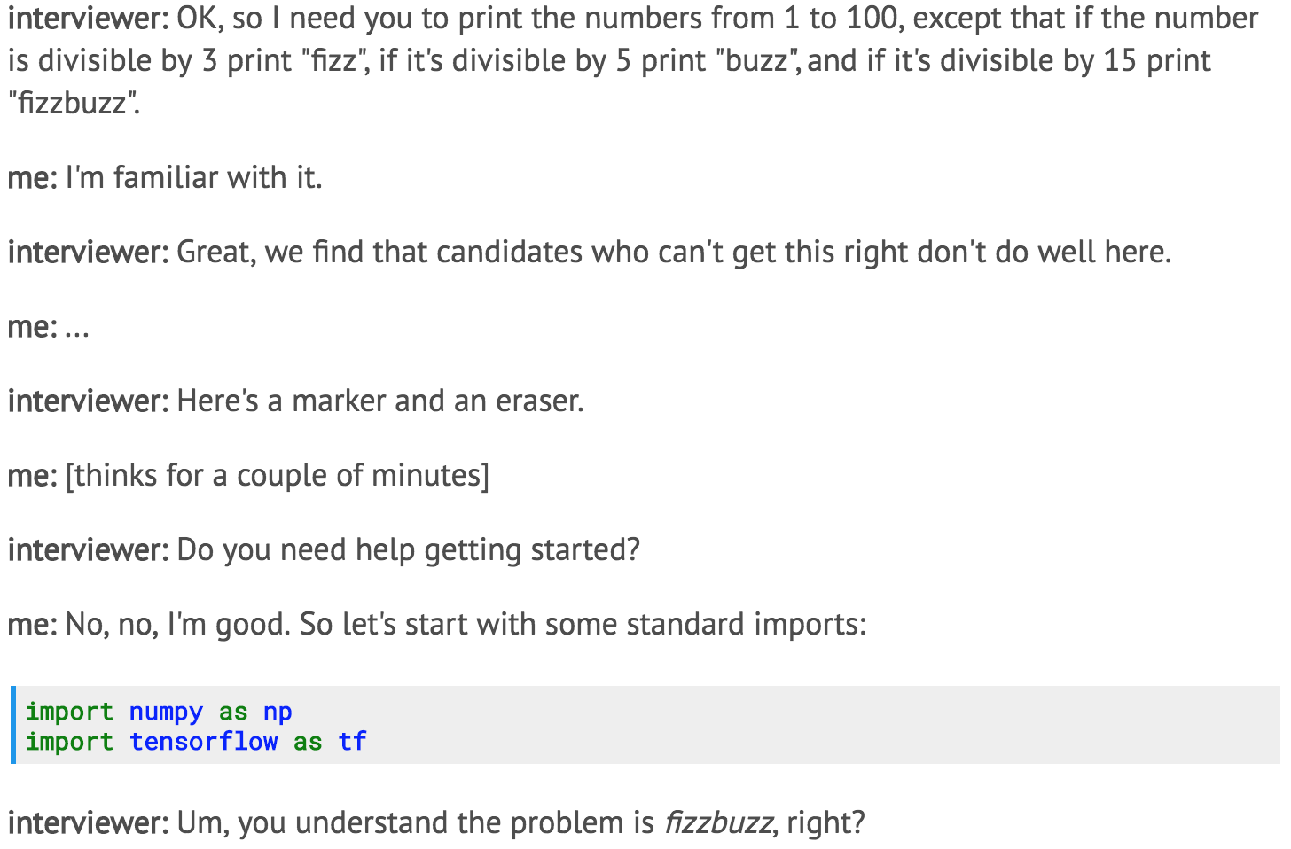

Slide 28
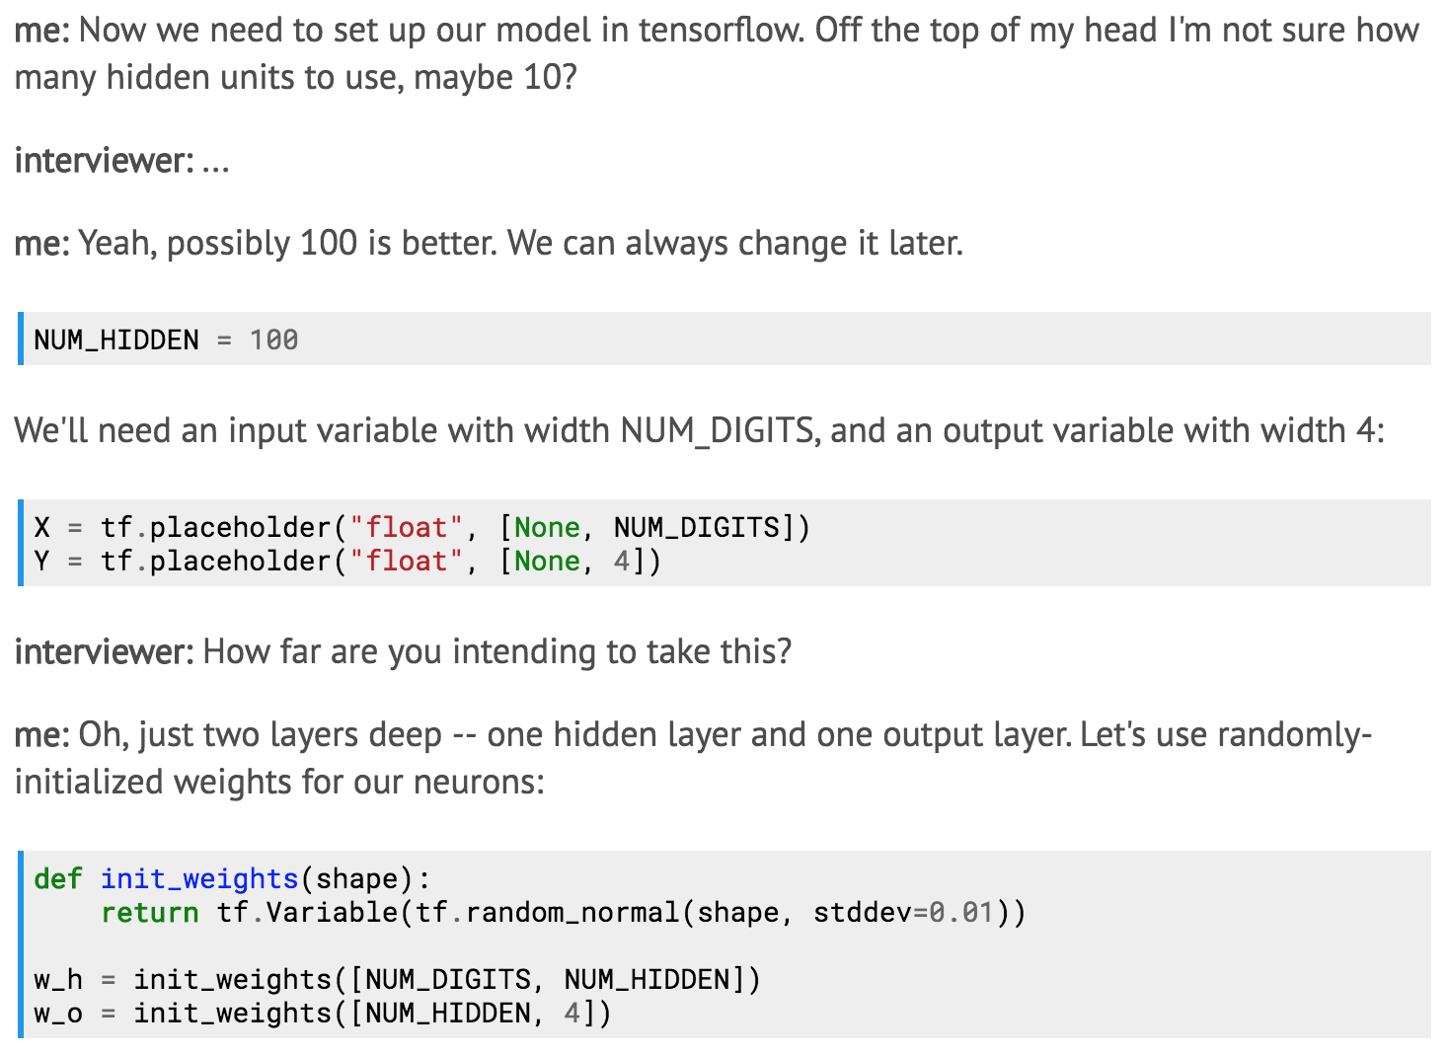

Slide 29
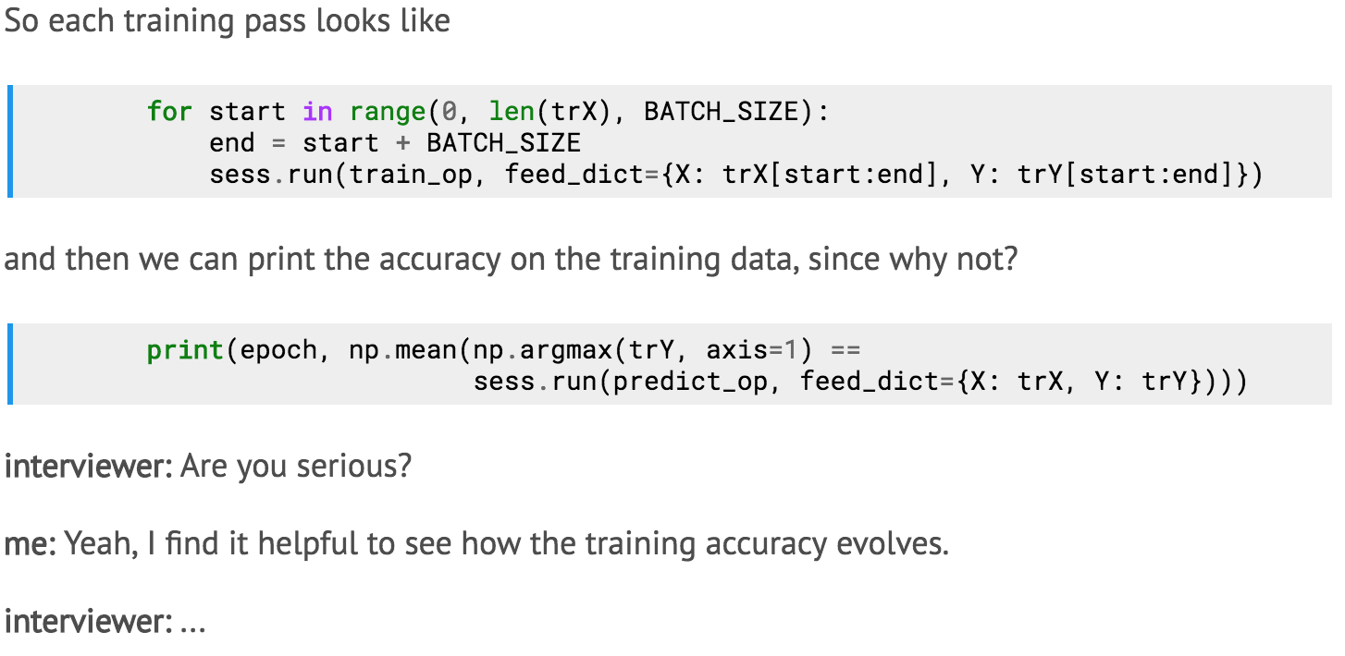

Slide 30
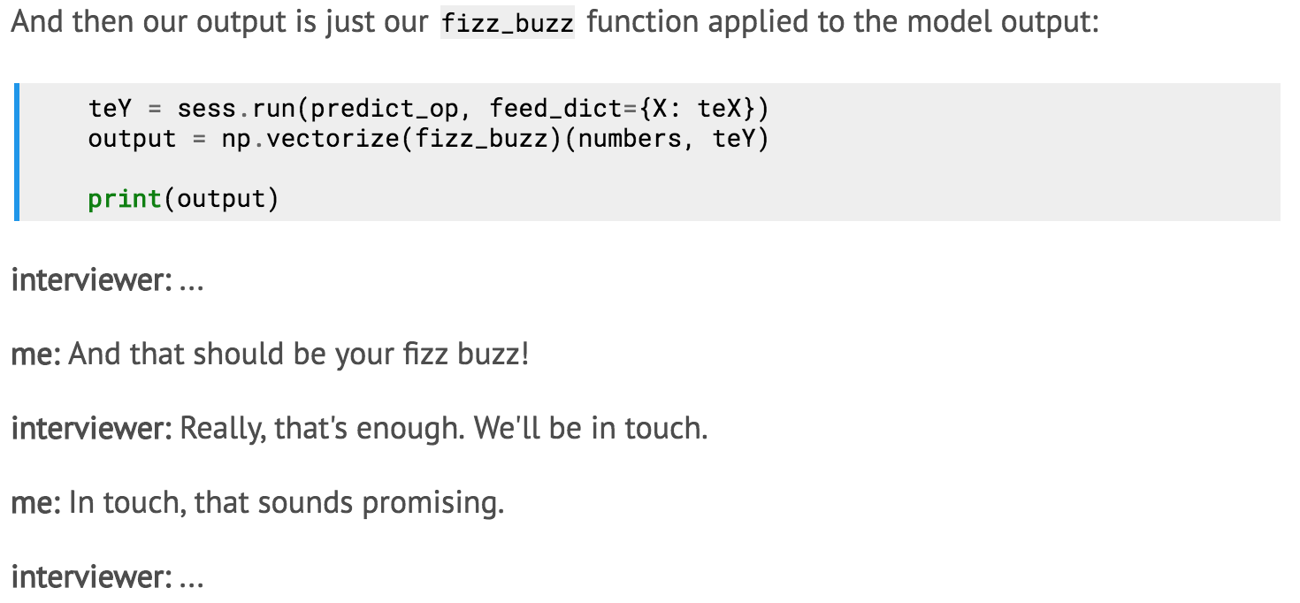

Slide 31
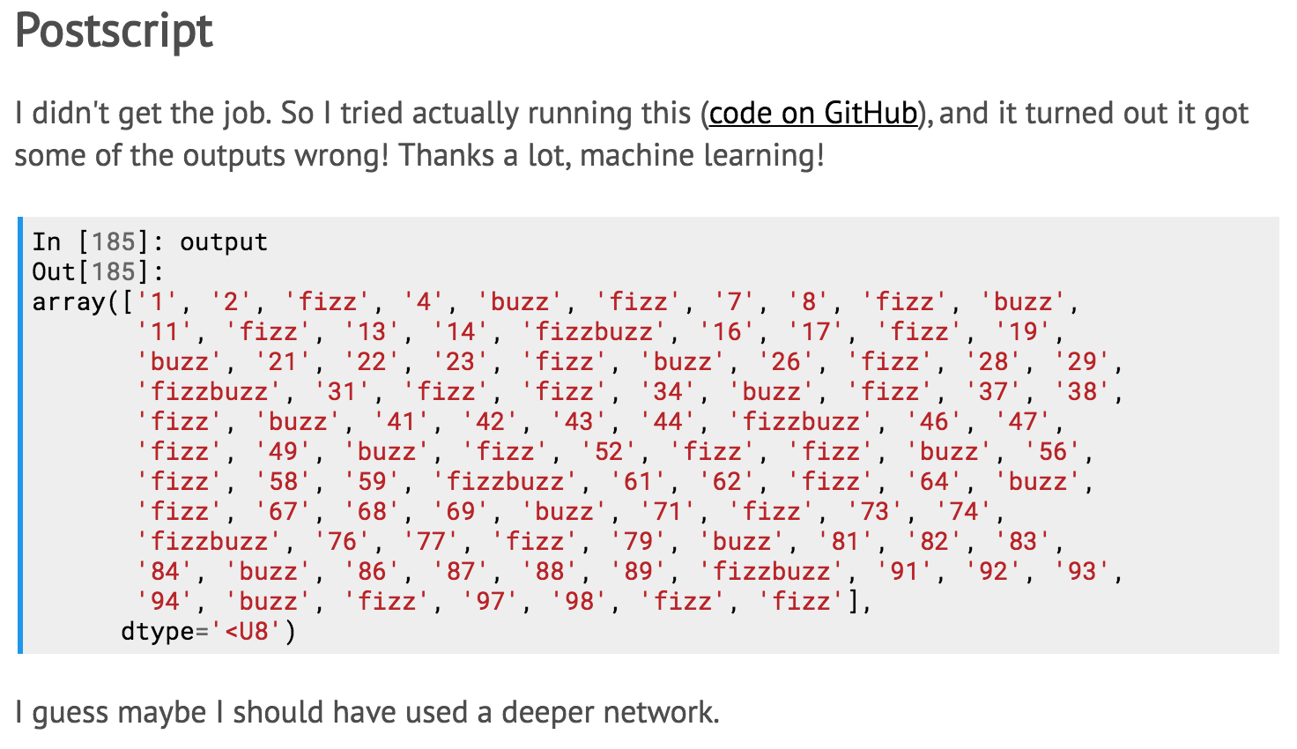

Slide 32
Next:
A walkthrough of various architectures (CNNs, RNNs, autoencoders, GANs, Transformers, etc)
Swappable architectural units
Theory
Application strengths and weaknesses
Final project updates
#1 is due a week from today! (March 27)
#2 is due two weeks later (April 10)
Final project presentations are the last week of class (April 22-24)
Homeworks
HW4 due March 31
HW5 comes out March 31, due April 15

Slide 33
Questions?

Slide 34
References
“Why is Deep Learning Taking Off?” https://www.coursera.org/learn/neural-networks-deep-learning/lecture/praGm/why-is-deep-learning-taking-off
TensorFlow Playground http://playground.tensorflow.org/
“My neural network isn’t working! What should I do?” http://theorangeduck.com/page/neural-network-not-working
“Don’t use deep learning, your data isn’t that big” https://simplystatistics.org/2017/05/31/deeplearning-vs-leekasso/
“Fizz Buzz in Tensorflow” http://joelgrus.com/2016/05/23/fizz-buzz-in-tensorflow/

